Slide 1
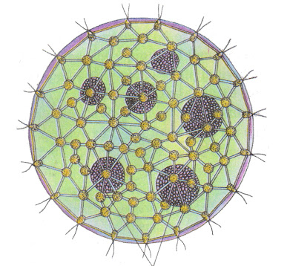
Volvox
Structure, Reproduction, Life cycle
Dr. Trilok Kumar
Govt. Digvijay Autonomous PG College, Rajnandgaon, C.G.

Slide 2
Volvox
Classification: Fristch
Division: Thallophyta
Sub-division: Algae
Class: Chlorophyceae
Order: Valvocales
Family: Volvocaceae
Genus: Volvox
More than 20 Species of Volvox are known.
e.g.: Volvox aureus, V. globator, V. merelli, V. prolificus etc.

Slide 3
Occurrence
Volvox is fresh water algae.
Found in: Ponds, lakes,, rivers, ditches etc.
It is found as minute green ball.
It is also known as Rolling algae.
Water colour became green when it is present in excess.

Slide 4
Structure of Volvox
Volvox is a Spherical colonial algae.
Colony of Volvox is called Coenobium and it is motile.
It is also known as Rolling algae.
Diameter of each colony is about 0.5mm.

Slide 5
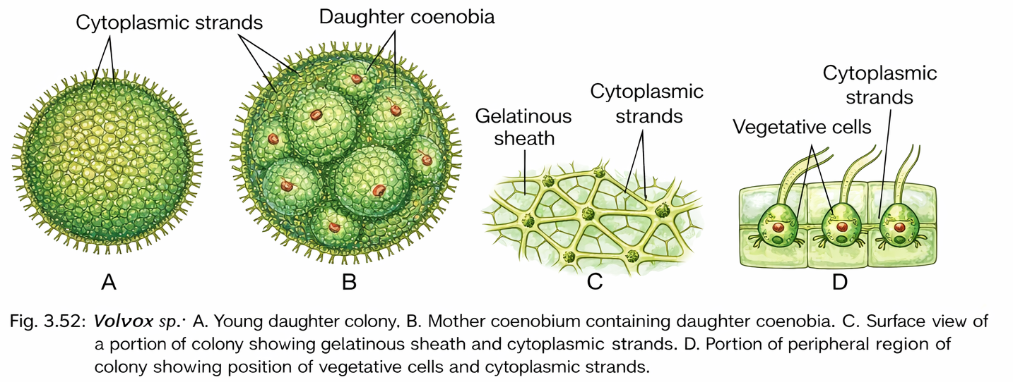
Structure of Volvox
Coenobium:
Each coenobium possess a large number of cells which are in multiple of two.
Each colony is covered by a mucilaginous layer and each cell is also covered by gelatinous sheath.
Cells are separated by Cytoplasmic strands.
No. of cells in each colony may differs (Depends on Species).
No. of cells in the colony various from 500 to 60000.
Cells arranged in peripheral are single layered & flagellated.

Slide 6
Types of Cells +nt in Coenobia
3 types of cells are +nt:
1. Vegetative cells:
These are flagellated peripheral cells.
Helps in locomotion and synthesis of food material.
2. Asexual cells:
These are non-flagellated and non-motile.
They are involved in formation of daughter colony.
3. Sexual cells: 2 types of sexual cells are embedded in the coenobia:
Male sexual cell: Responsible for the formation of male gametes (Antherozoids).
Female sexual cell: Responsible for the formation of female gamete (Egg).

Slide 7
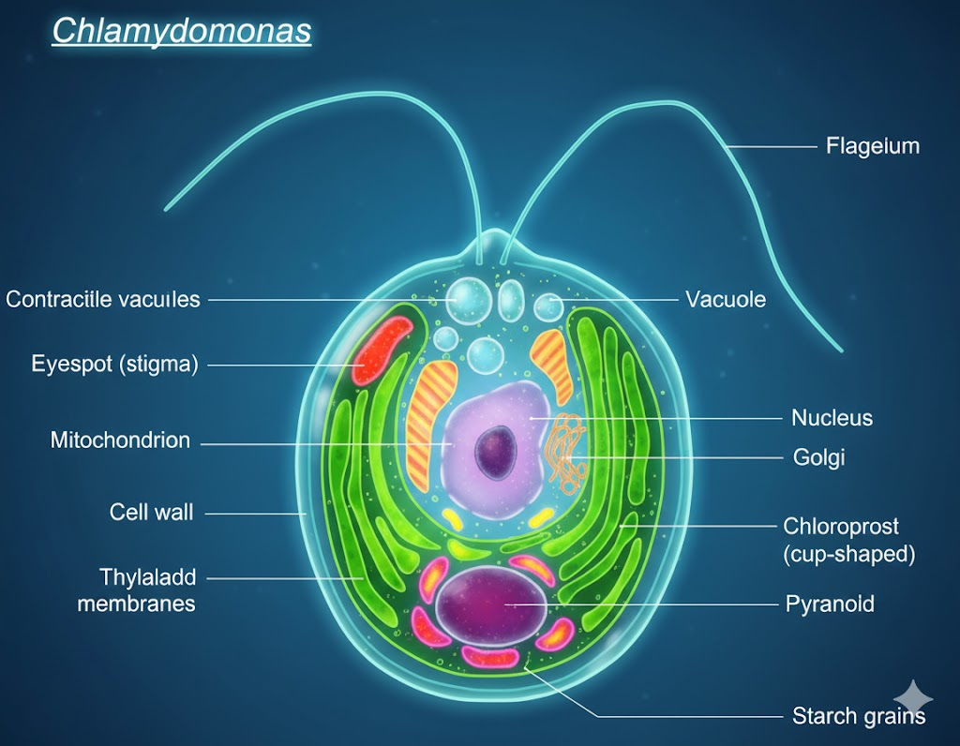
Structure of Single Cell
Each cell is pear shaped.
It contains cup-shaped chloroplast.
Each chloroplast has a pyrenoid (Pyrenoid: A proteinaceous structure within the chloroplast involved in starch synthesis and storage.)
Each peripheral cell has an eye-spot, two contractile vacuoles, a centrally located nucleus and two anterior flagella.
Flagella are equal in length.
Central cells do not have flagella.

Slide 8
Reproduction in Volvox
Reproduction in Volvox takes place by two methods:
1. Asexual reproduction
2. Sexual reproduction

Slide 9
1. Asexual reproduction
A few cells in the posterior half of the coenobium take part in asexual reproduction.
These cells become enlarged in size, withdraw their flagella and become globose in shape.
This reductive cells are called Gonidia or parthenogonidia or autocolony initials.
The protoplast of each gonidium successively divides longitudinally to form 2 celled stage, 4 celled stage and 8 celled stage (Plakea stage or cruciate plate), 16 celled stage respectively.
Finally a hollow sphere is formed with a small aperture. This aperture is called Phialopore.
The division of these cells continues until a specific number of cells in the colony is attained.
These cells move towards phialopore for inversion of the cells.
The both ends of the cells finally meet together.
After inversion, flagella is formed in each cells.
Mucilaginous layer is formed around them to form daughter colony.
Several daughter colony is formed inside parent coenobium.
Finally the young colonies escape either by the disintegration of the parent colony or through a pore at the position of the original gonidium.
Increase in size of the colony later is partly due to the cell enlargement and mainly to the swelling of mucilaginous layer.

Slide 10
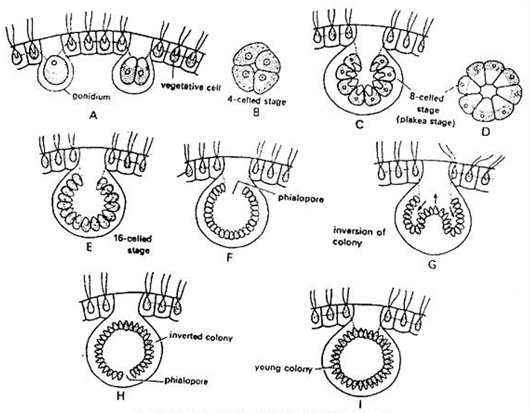
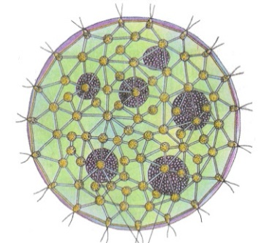
Diagrammatic representation of Asexual reproduction
A-D : Development of plakea stage (from 2 to 8 celled stage) E: 16 celled staged
F: formation of Hollow sphere & Phialopore
G-H: Stages of Inversion and formation of Inverted colony I: Daughter colony

Slide 11
Sexual Reproduction
Sexual reproduction in Volvox is Oogamous Type.
Male sex organ is called Antherida & Female sex organ is called Oogonia.
Male and feamle sex organ may be formed in same or different thalli.
Volvox aureus is Dioecious (heterothallic) and Volvox globator is Monoecious (homothallic).
Volvox aureus is dioecious, meaning male and female gametes are produced on separate colonies. In contrast, Volvox globator is monoecious with both antheridia and oogonia developing within the same colony.

Slide 12
A. Development of Antheridia
The development of antheridium starts with formation of antheridial initial or androgonidial cell mostly in posterior side of the colony.
The initial cells become enlarge, lose flagella, protoplasm becomes dense and nucleus becomes larger.
The antheridial initial shifts inside towards cavity and remains connected to other vegetative cells through cytoplasmic strands.
The protoplast of antheridial initial divides, longitudinally to form 16-512 elongated cells.
The cells remain in plate like structure or arrange in a hollow sphere.
The inversion of cells also takes place as in asexual reproduction.
Each cell differentiates in antherozoid or spermatozoid.
The antherozoid is spindle shaped, elongated, bi-flagellated structure containing two contractile vacuoles, nucleus, cup shape chloroplast, pyrenoid and eye spot.
It is pale yellow or green in colour.
The antherozoids are released individually or sometimes in groups.

Slide 13
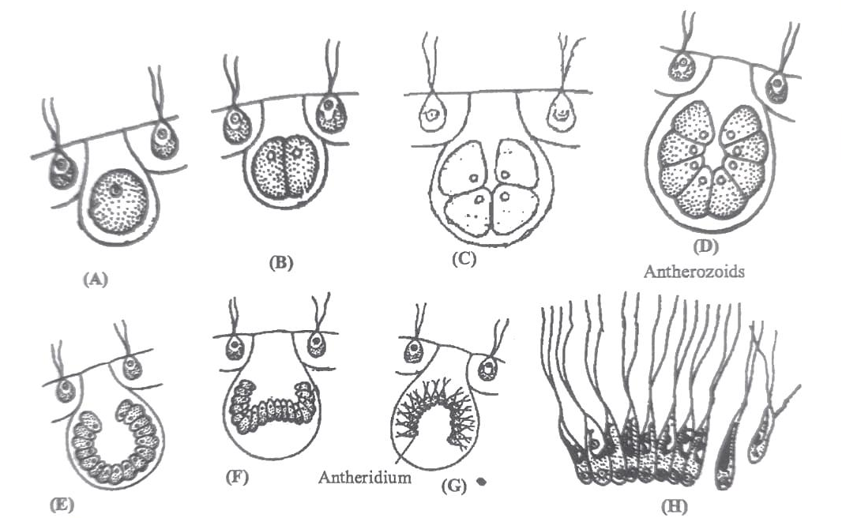
Development of Antheridia
Fig: Volvox: A-G Various stages of the Development of Antheridia H-Antherozoids

Slide 14
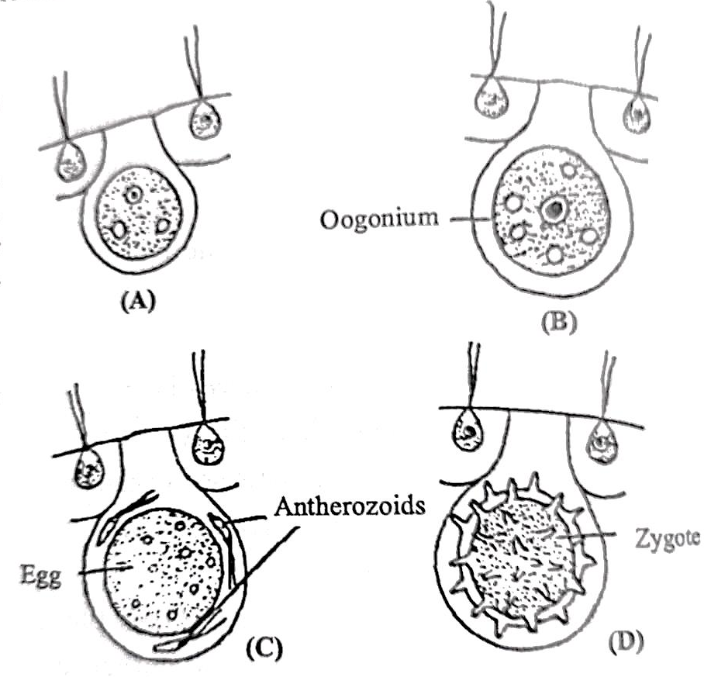
B. Development of Oogonia
Single vegetative cell of the colony at the posterior side withdraws its flagella, enlarges in size and become a flask-shaped structure called oogonium.
It is green in colour and has parietal chloroplast. It has many pyrenoids and large amount of reserve food.
The mouth of the flask- shaped oogonium opens towards the outer surface of the colony.
The entire protoplast without undergoing any division, forms an uninucleate, non-flagellated egg or female gametophyte or ovum.
Volvox: A-Developing oogonia
B- Mature oogonia
C- Fertilization
D- Zygote

Slide 15
Fertilization of Volvox
After liberation from antheridium, the antherozoids swim freely on surface of water.
Due to chemotactic response the antherozoids reach the oogonia. Some antherozoids enter each oogonium.
Only one antherozoid enters inside the oogonium through receptive spot.
After this plasmogainy i.e., fusion of male and female cytoplasm and karyogamy i.e., fusion of male and female nuclei take place.
This results in formation of diploid zygote. The diploid zygote secretes a three layered thick wall.
The layers of the wall are exospore, mesospore and endospore.
The outer exospore is thick. It may be smooth e.g., V. aureus or spiny e.g., V. globator.
The mesospores and endospores are thin and smooth.
The walls contain nucleus pigment haematochrome which imparts red colour to the zygote.
The zygotes are released by the disintegration of parent colony. Then zygotes undergo a period of dormancy

Slide 16
Volvox: A-Developing oogonia
B- Mature oogonia
C- Fertilization
D- Zygote

Slide 17
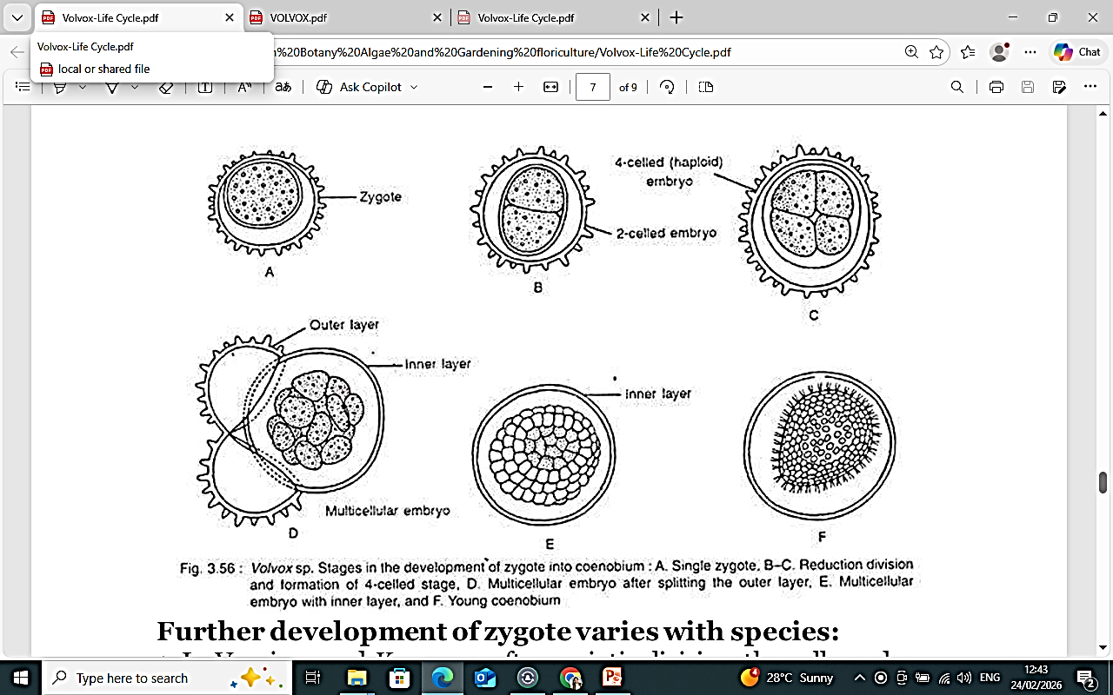
Germination of Zygote:
The dormant zygote germinates on favourable climatic conditions.
The diploid nucleus of zygote undergoes meiotic division forming four haploid cells.
The outer two layers of zygote burst and the inner layer comes out as vesicle.
The four haploid cells migrate with the vesicle .
The development of new colony from zygote differs in different species of Volvox.

Slide 18
In V. aureus and V. minor the protoplasm of zygote divides repeatedly until the cell number of colony is reached and new colony is formed as in asexual reproduction process.
In V. campensis the protoplast of zygote divides to make many biflagellate zoospores.
Only one zoospore survives and all other disintegrate.
This zoospore comes out of the vesicle it divides to make many cells which arrange to form a colony.
In V. rousseletii the zygote forms a single biflagellate zoospore, the protoplast of zoospore divides and forms a colony.
In all the methods the cells divide and undergo inversion to make a mature colony.

Slide 19
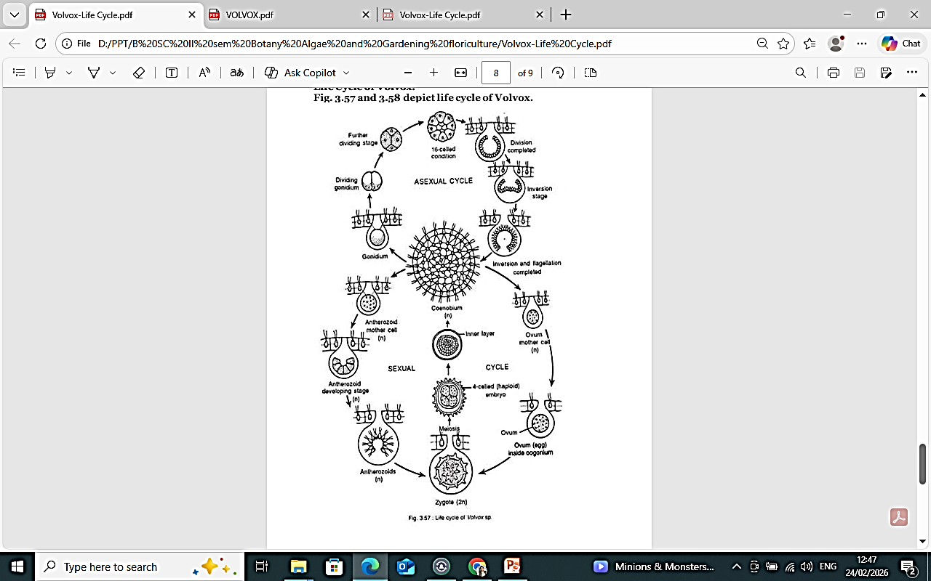
Life cycle of Volvox
Volvox is haploid (n) algae, the haploid gametes fertilize to make diploid zygote (2n) which divides by meiosis to make haploid cells (n) which mature into haploid Volvox colony

